Slide 1


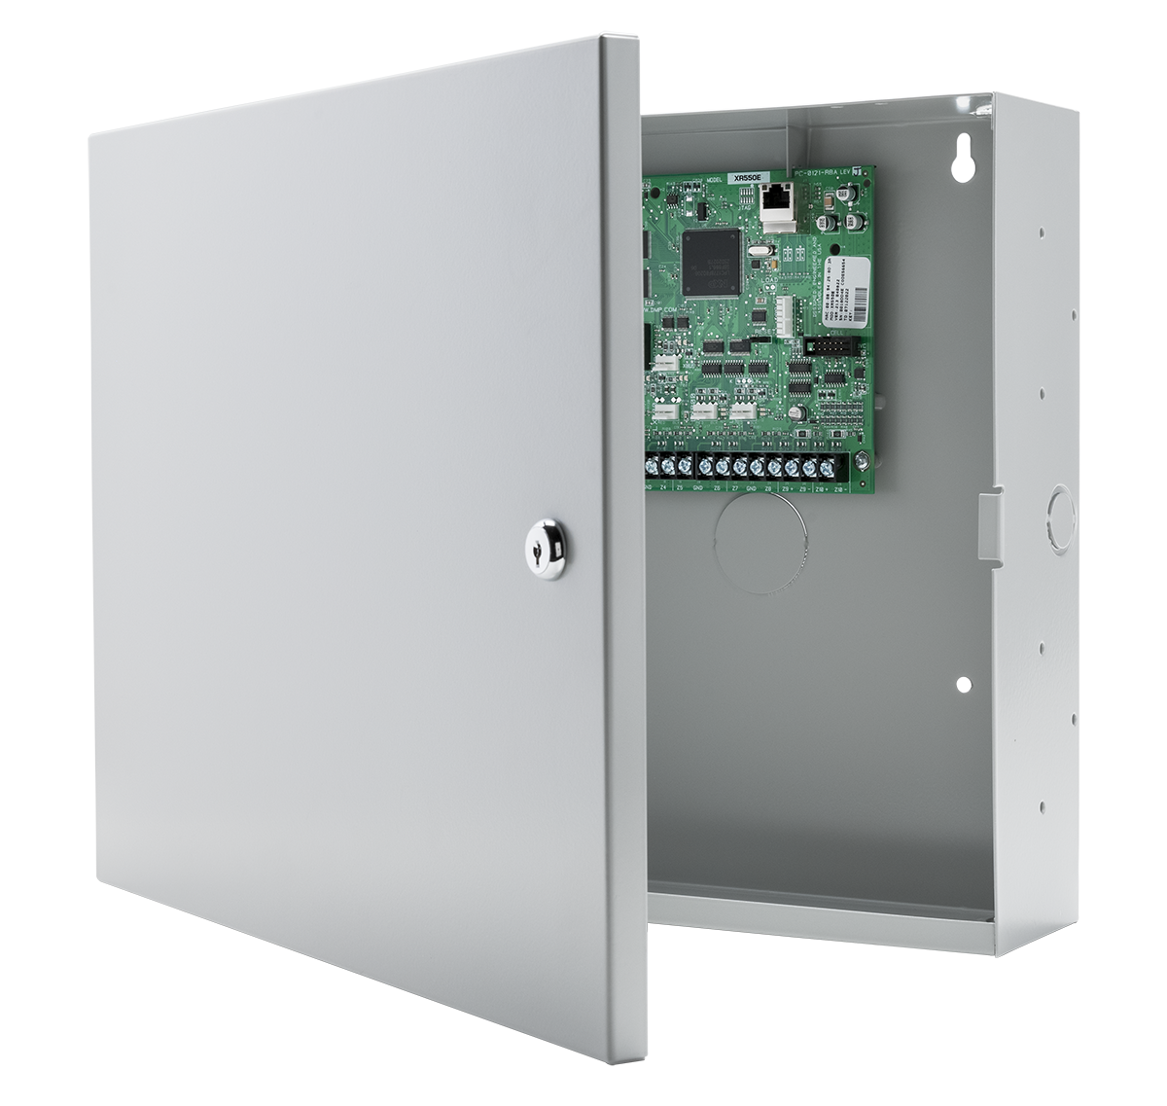
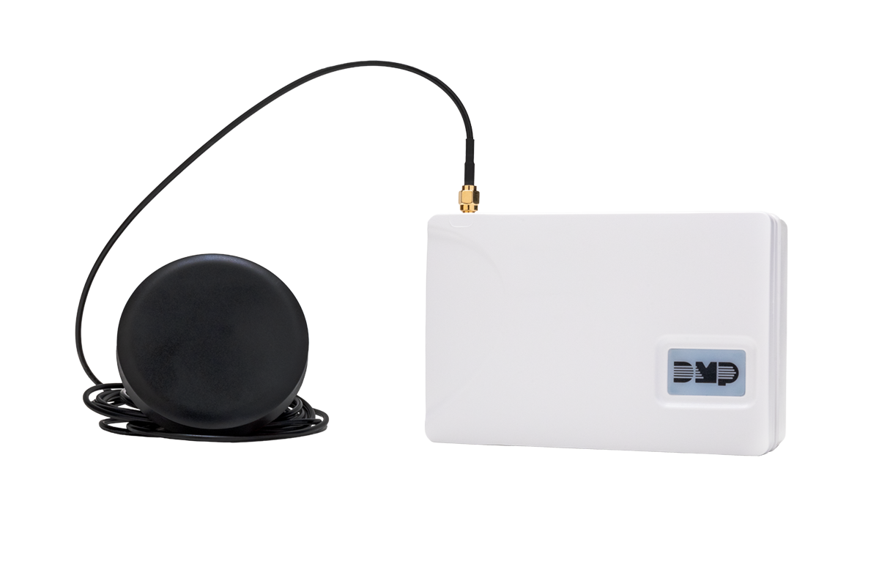
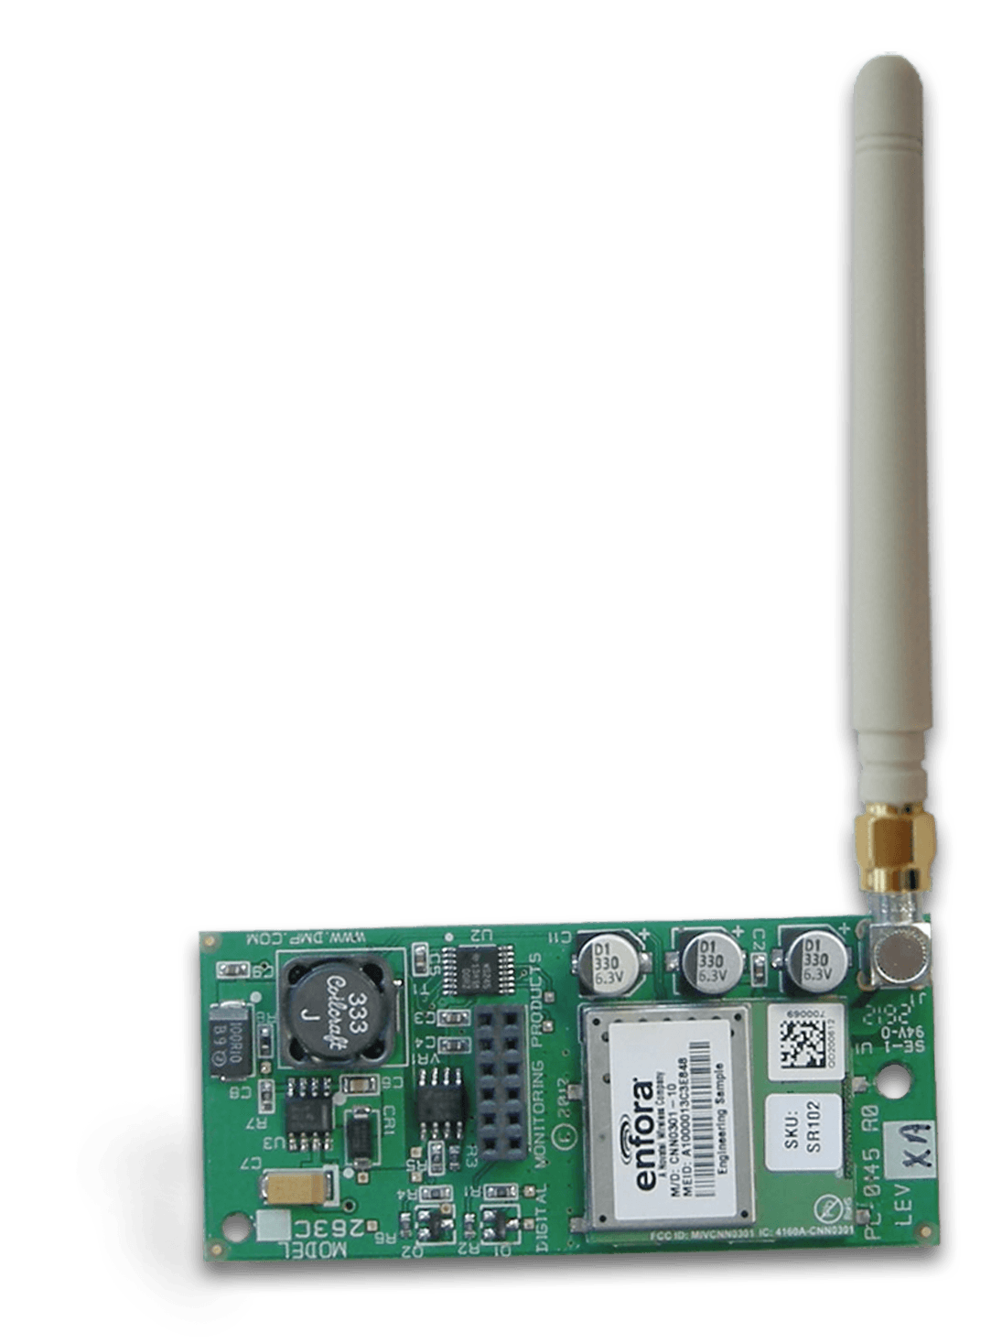

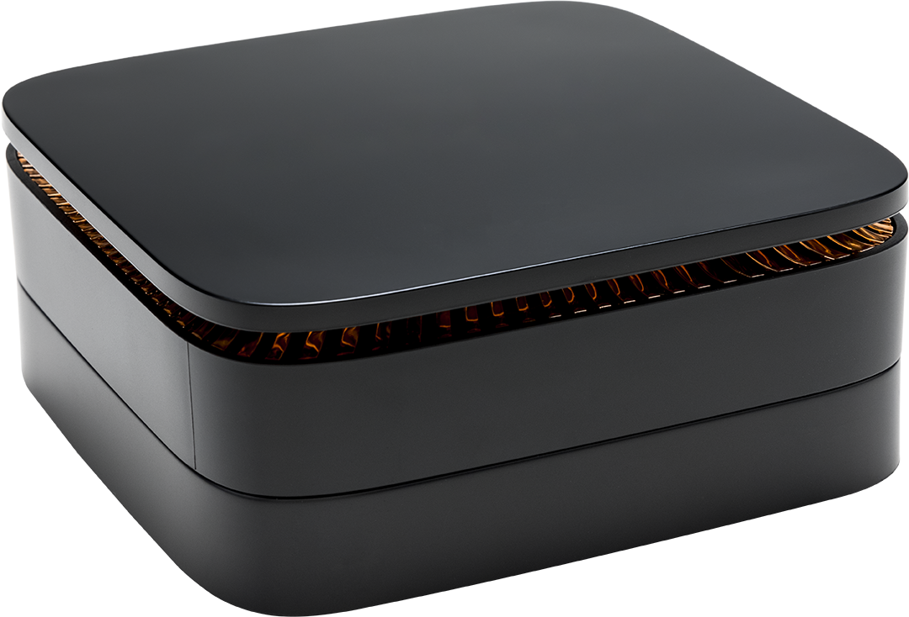
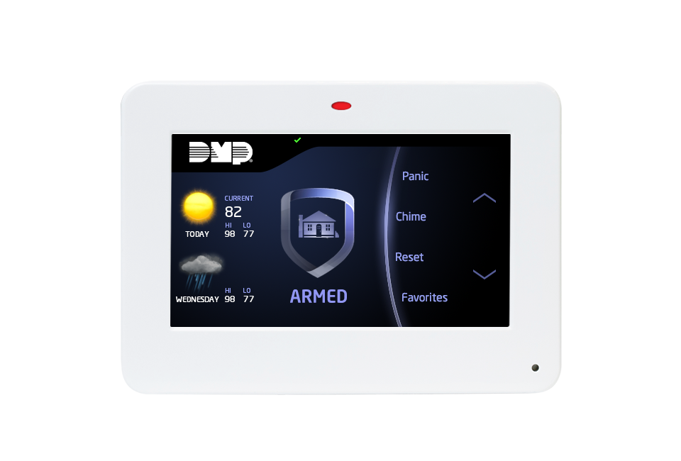
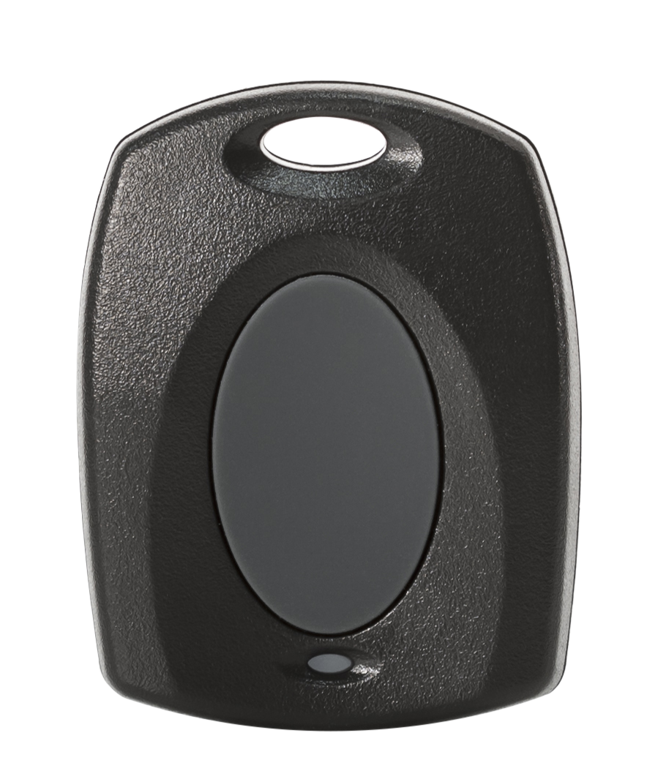
Digital Monitoring Products
The Standard for Bank Security

Slide 2
Protecting the largest financial
institutions since 1988.

Slide 3

THE GOLD STANDARD
Financial Industry Key Priorities
Customer and employee safety
Asset protection
Audit compliance
Risk mitigation
Information management

Slide 4

Why Financial Institutions Select DMP
Manufactured in U.S.A. with U.S. and global components
11 of the top 13 banks trust DMP for branch and ATM security
Network communications experience: 35+ years
Managing conversion projects: 25+ years
Easy replacement of existing production systems
Forward and backward compatibility
Fully integrated intrusion, fire and access control
Custom features designed for the financial industry
Advanced audit compliance and reporting solutions
80-hour disaster recovery power supply
UL and ULC compliance

Slide 5
XR Series
AN INTEGRATED SOLUTION

Slide 6
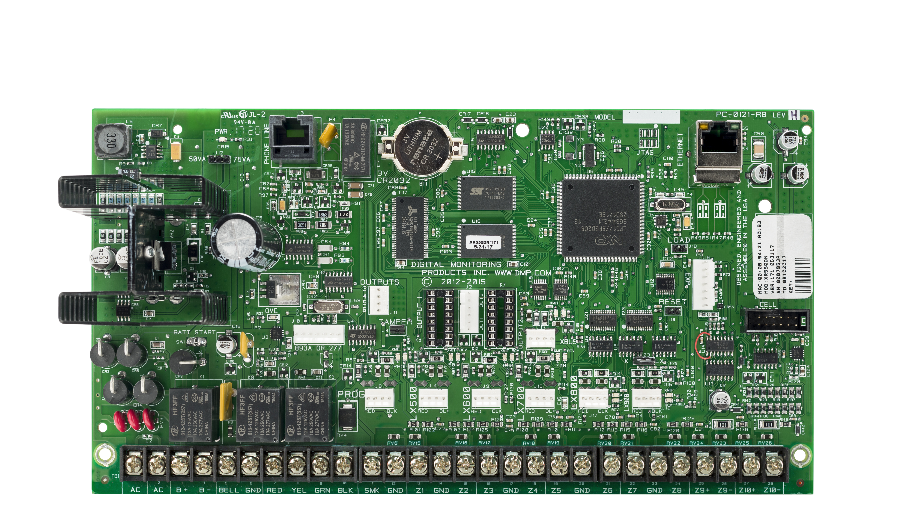
XR550 CONTROL COMMUNICATOR
Access & Intrusion Highlights
Encrypted network and cell communications
10 zones on board. Zones 1-8 selectable EOL value for any resistance
Expandable to 574 zones
500 DMP wireless zones
506 outputs
32 areas
96 access doors
99 schedules
99 user profiles and 10,000 user codes
12,000 event buffer
With version 231 (1.25.24) up to 95 XR Series panels can communicate with each other across the same network.

Slide 7
Advanced Bank Features
XR550 CONTROL COMMUNICATOR
Early Morning Ambush
When an associate enters their code at the keypad a timer (1-15 minutes) begins. The associate must enter their code a second time before the timer ends. If the timer expires, a silent (Early Morning Ambush) message with the user’s ID will be sent to the monitoring center.
Benefit: Employee safety, audit compliance
Inactive User Monitoring
If a code is not used within a programmable number of days (1 – 425 days), the panel will transmit the user’s name, number and an “inactive user” message.
Benefit: Enhanced security, audit compliance
Allow Users to Change Their Own Code
Allows users without user code authority to change only their own code.
Benefit: Audit compliance
Temporary User Codes
Programmable with both start and end date and time.
Benefit: Audit compliance, operational efficiencies
Technician Disarming Restriction
Technician may not disarm selected areas which were last armed by an associate.
Benefit: Insider threat mitigation

Slide 8
Advanced Bank Features
XR550 CONTROL COMMUNICATOR
Dual Authority
Requires two user codes to be entered at the keypad to disarm and/or arm the selected area(s). After first code is entered the keypad will display ENTER 2nd CODE. Both codes must be of equal authority or higher.
Benefit: Eliminates opening logs
Panic Test
Allows the panic zone test results to be sent to the monitoring center. The system test start, stop, panic
zone verification and panic zone failure messages are each sent.
Benefit: System integrity, audit compliance
Inactive Zone Auditing
Zones are monitored for activity in both the armed and disarmed state. If a zone does not change status over the selected number of days (1 – 365 days), an “inactive zone” message is sent with the zone name, number and account number.
Benefit: System integrity
False Alarm Question
This option allows the associate to investigate a burglary alarm prior to disarming the system. The keypad displays IS THIS A FALSE ALARM? NO OR YES. Selecting NO transmits username, alarm and VERIFIED to the monitoring center. Selecting YES sends username,
alarm and CANCEL.
Benefit: Reduce false alarms & police dispatch fines

Slide 9
Advanced Bank Features
XR550 CONTROL COMMUNICATOR
Late To Open
If a branch has not disarmed within a selected number of minutes (1 - 240) after the “opening time schedule,” a “late to open” message is sent to the monitoring center.
Benefit: Employee accountability, employee safety, OCC compliance
Early To Close
If a branch arms within a selected number of minutes
(1 - 240) prior to the “scheduled closing time,” an “early to close” message is sent to the monitoring center.
Benefit: Employee accountability, OCC compliance
Card Plus PIN
Requires a user to present both a credential and enter a PIN before the desire action for the specific area(s) will occur.
Benefit: Enhanced security
Enhanced Zone Test
“Walk Test” - Allows enhanced zone testing of panic and burglary zones. When the test ends, a summary message with the user’s name and number, the zones successfully tested and the zones not successfully tested is sent to the monitoring center.
Benefit: System integrity, audit compliance
Schedule Override
The programmed door schedule will follow the arming status of the panel to eliminate the need for holiday schedules. Prior to unlocking at a scheduled time, the door will check the status of the selected area and will remain locked if the area is still armed.
Benefit: Facility security, customer safety

Slide 10
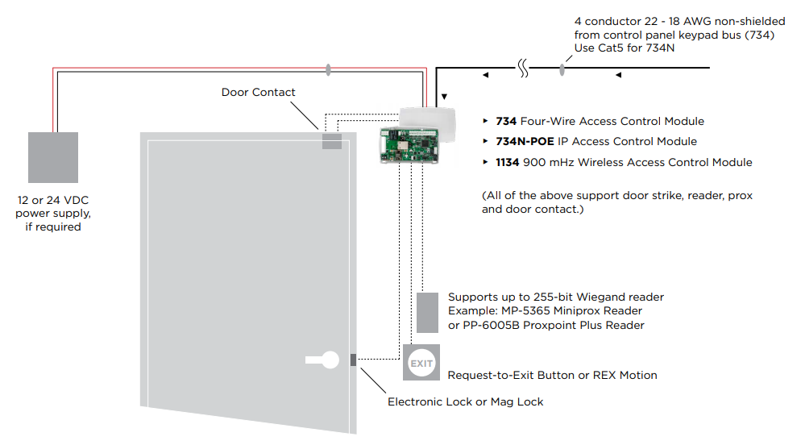
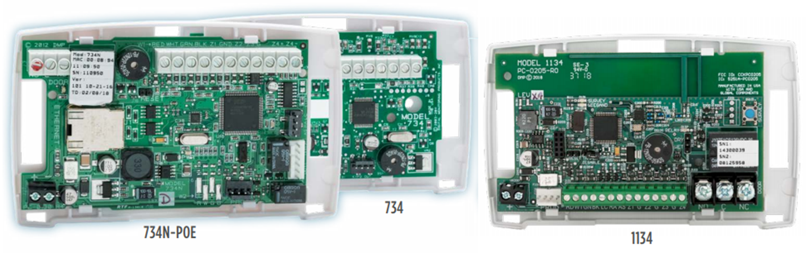
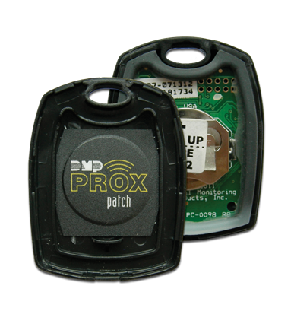
Advanced Bank Features
Full-Featured, Flexible, Integrated Access Control
System Capacity
Wiegand or OSDP
Prox or high security cards
Support for up to 8 card formats
99 user profiles and 10,000 user credentials
96 supervised access doors
99 schedules
Network, Wi-Fi, PoE, wireless or wired access modules
1144-1P-PSV

Slide 11
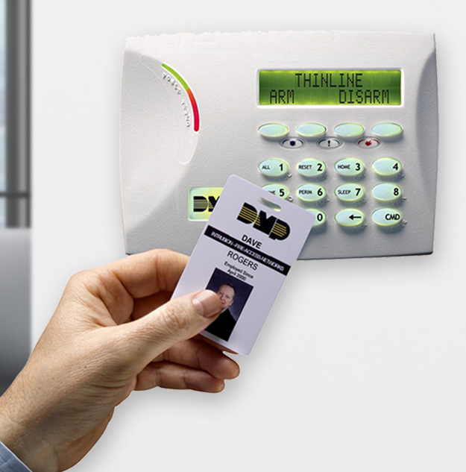
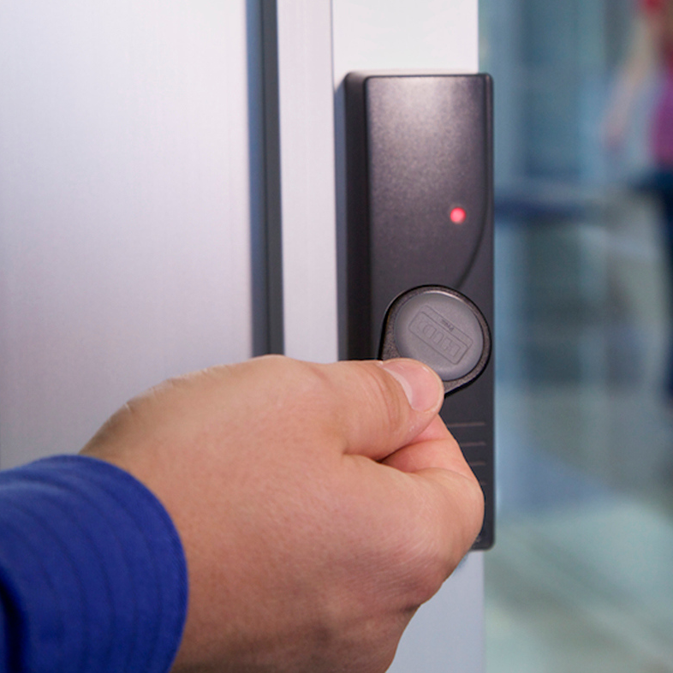
Integrated Keyless Access: Go Keyless
Access Control Features
Manage branch service providers (couriers, cleaners, ATM services)
Customized reporting for quick review of all access events
Create detailed user access rights (with permission to enter only
certain areas at certain times)
Instantly terminate all access privileges across all panels
Expand access to teller line, server room, drive up kiosk and ATM room
Allow or restrict by user profile and schedule
Hands free disarming and arming from DMP user keypad
Auto rearm schedules for service providers

Slide 12
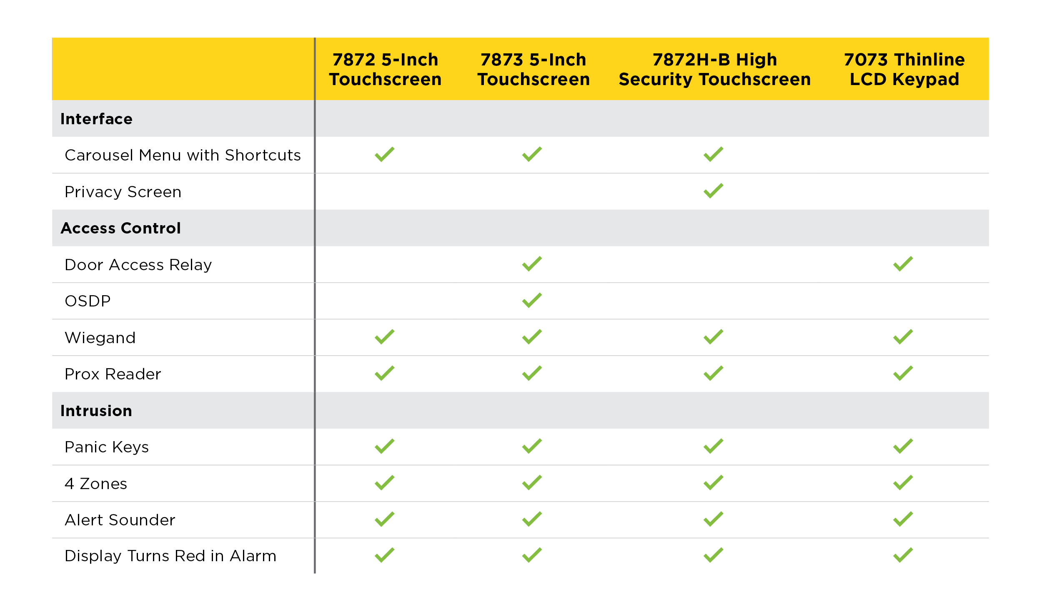
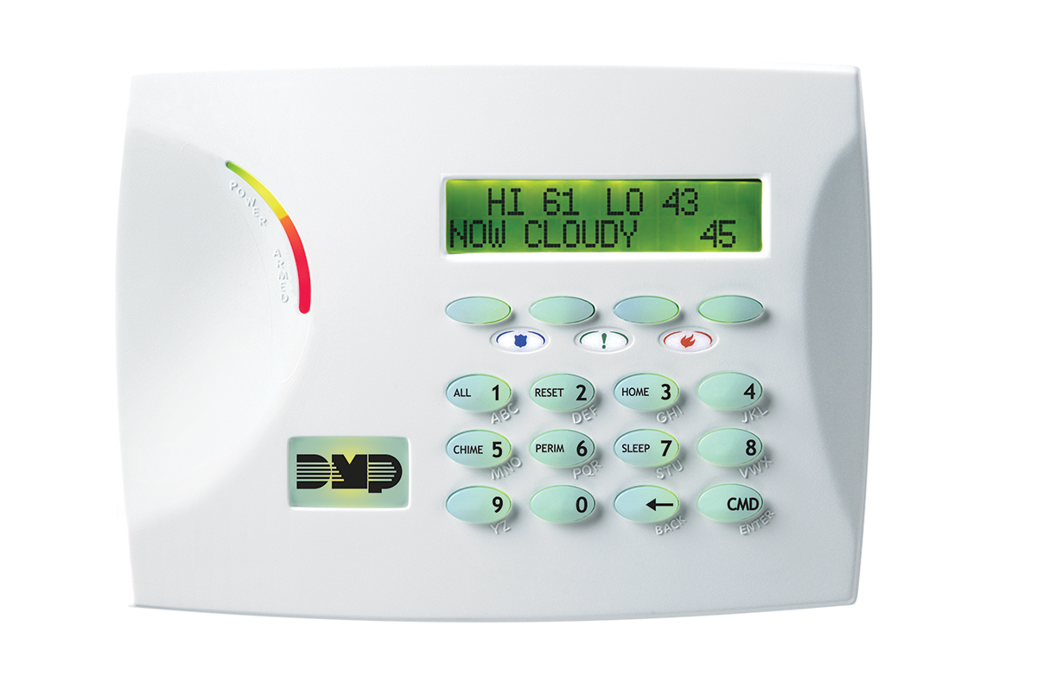
Keypad Options
7872 | 7873
7872H-B
7073

Slide 13
DMP SMART
Two-Way Supervised Wireless

Slide 14

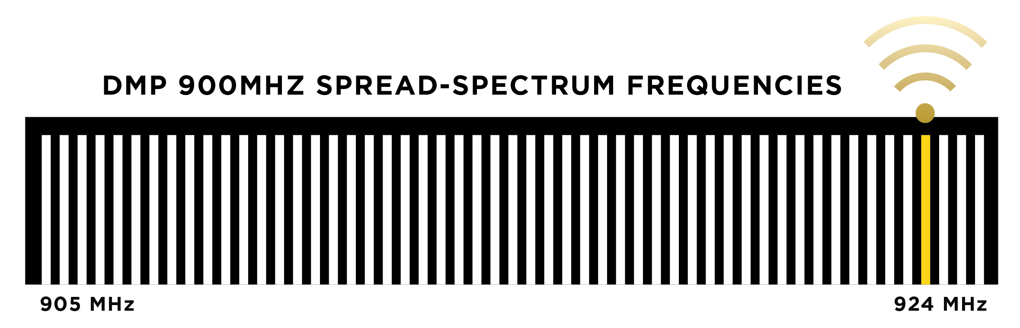
Two-Way Supervised Communications
905 - 924 MHz used for superior range
Jamming detection and notification
Smart motion detectors
Selectable supervision time (3 - 60 - 240)
  UL requires 3-minute check-ins, default is 240
Superior battery life
128-bit AES encryption optional
Portable duress transmitters for life safety
Test all hold ups and zones at the branch
Activate motion detector walk test feature from keypad
Support for up to 8 repeaters
Every 32 milliseconds, DMP 2-way wireless hops
to a new frequency across 53 frequencies.
The order is determined by the house code of the panel.

Slide 15
DMP IP-BASED
Cellular Communication

Slide 16
Digital Cellular Communications
Digital Cellular Communicator
CAT-M1 (4G LTE) cellular services with AT&T, Verizon or AT&T FirstNet
Direct IP to IP communication to DMP receiver
Standalone, primary or backup communications with UL listings
Remote panel programming over cellular
Multiple IP paths for business recovery or disaster planning
No intermediary server or additional hardware
Private VPN available
Exclusive Adaptive Technology™
AES 128- or 256-bit encryption available
Connected to and powered from XR550
Messages received in 3 to 5 seconds
Fully supervised
ACTIVATION READY
With XR version 201 all LTE units ever shipped from DMP activate immediately.

Slide 17
TMSentry Control Panel
THE NEXT GENERATION OF ATM SECURITY
™

Slide 18
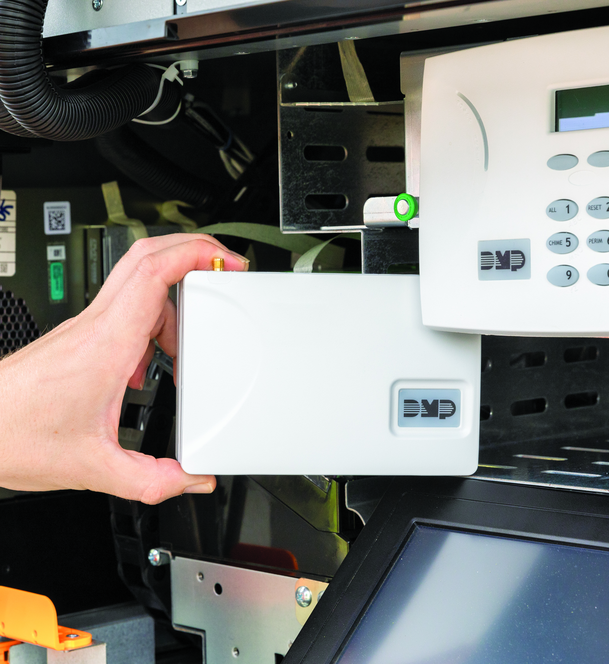
TMSentry
™
Designed, engineered and manufactured in the U.S with U.S. and global components.
The power of an XR in a compact footprint for newer, smaller teller machines. First-to-market solution for customer’s needs.
Six onboard supervised alarm zones and two aux outputs for full featured burglar alarm monitoring.
Network and cellular communications with Adaptive Technology™ ensure reliable signal transmission.
Encrypted communications to the monitoring center and Dealer Admin™.
24-hour battery backup provides continuous operation and alarm transmission during power outages.
Powerful features such as Inactive User Audit, Zone Inactivity Audit, Auto Rearm Delay and Schedules.
DIMENSIONS
5.50” W x 3.75” L x 2.56” H

Slide 19
XV Gateways with AlarmVision
TURN EXISTING CAMERAS INTO INTELLIGENT MOTION DETECTORS
™

Slide 20
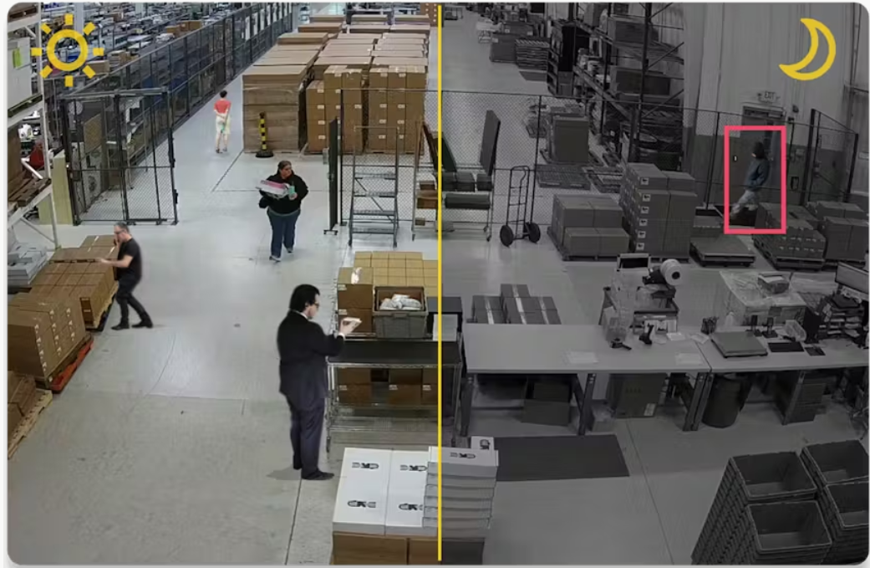
XV Gateways with AlarmVision
Turn Cameras into Powerful Alarm Detection Devices
™
Benefits
Person, vehicle and animal detection and analysis
Up to 4 detection regions per camera
Each region is an intrusion zone on an XR Series control panel
ONVIF and RTSP camera compatibility
1TB – 4TB internal storage
Continuous recording stored locally
24 – 96 MP processing
Dual NIC for network connectivity
NDAA compliant
Q2 2024: Immix integration | Loitering
Q3 2024: Line Cross | Direction of Travel

Slide 21

Notes:
DMP is a family-owned manufacturer of electronic burg/fire/access products. Since 1975 we have designed, built, distributed & supported those products from our headquarters in Springfield, MO. We sell directly to preferred alarm companies who are passionate about providing life-safety and peace-of-mind and focused on recurring monthly revenue. This is our only business.

