Slide 1
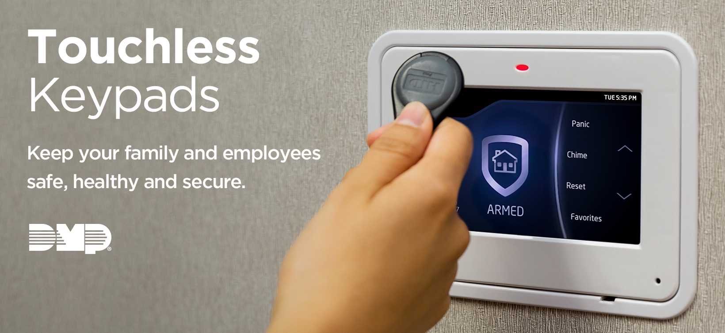

Slide 2
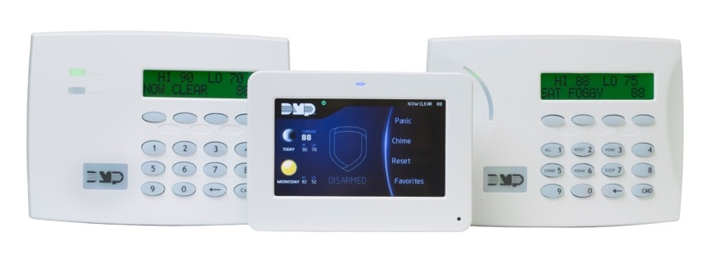
Touchless Keypads for Times Like Now
The recent Pandemic creates an immediate need to avoid touching public surfaces.
Graphic Touchscreen keypad and Thinline keypads let you arm or disarm your system without touching the screen or the
buttons to enter your code.
Present your proximity
credential to the keypad
and eliminate the risk.
Keep your family and
employees safe, healthy
and secure.

Slide 3
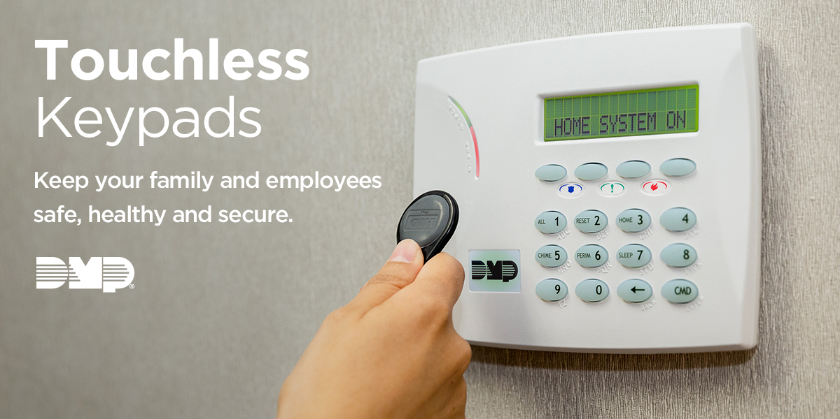
Touchless Keypads for Times Like Now
At home and work, credentials are a perfect tool to give employees, baby sitters, after-hours cleaning services — anyone you authorize —
a touchless way to interact with your keypad.

Slide 4
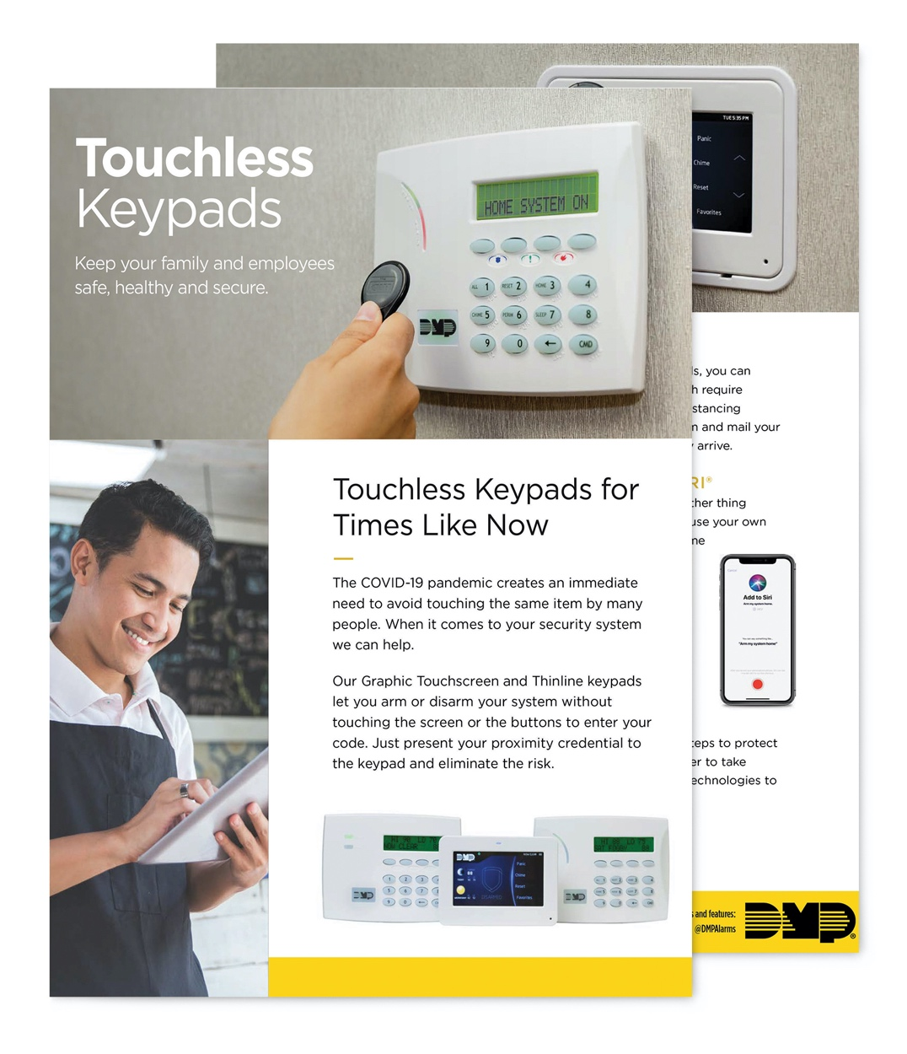
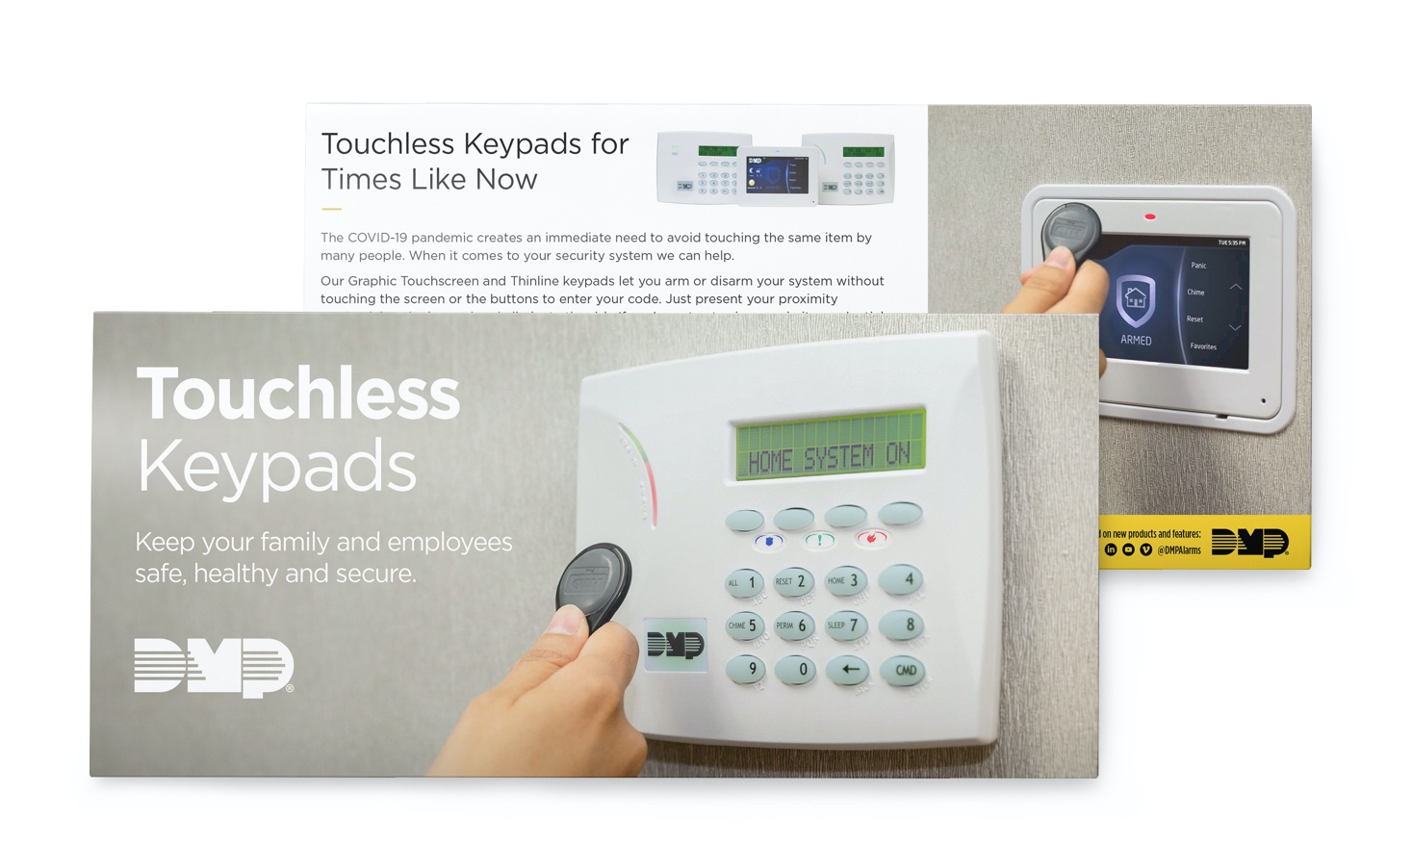
Touchless Keypads for Times Like Now
New Customizable Assets
Available In MarketingCentral

