Slide 1
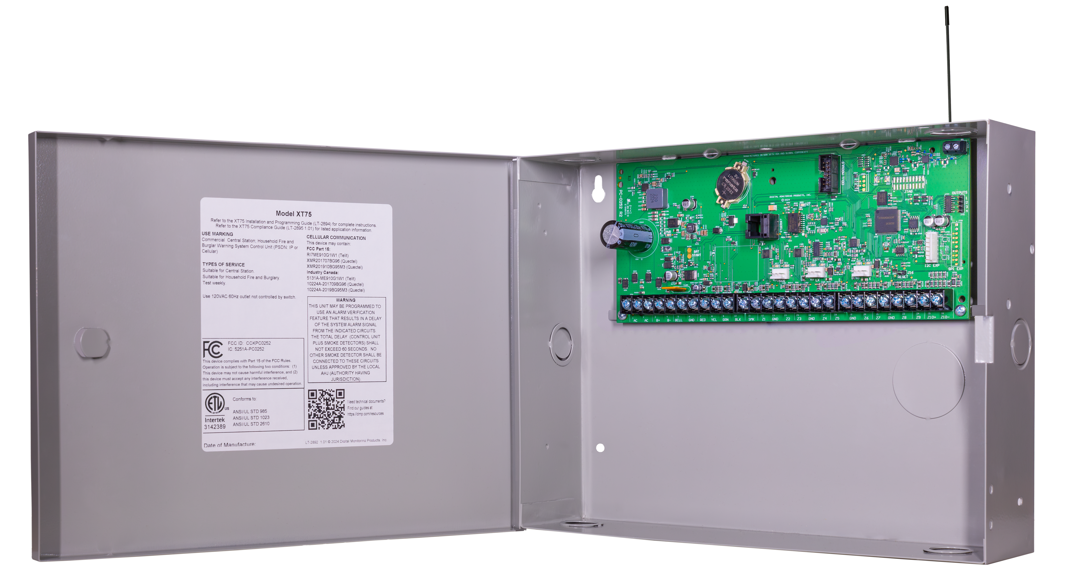

Welcome to XT Series Training!

Slide 2
Meet Today’s Trainer
YOUR NAME HERE
YOUR TITLE HERE
youremail@dmp.com
417-555-5555

Slide 3
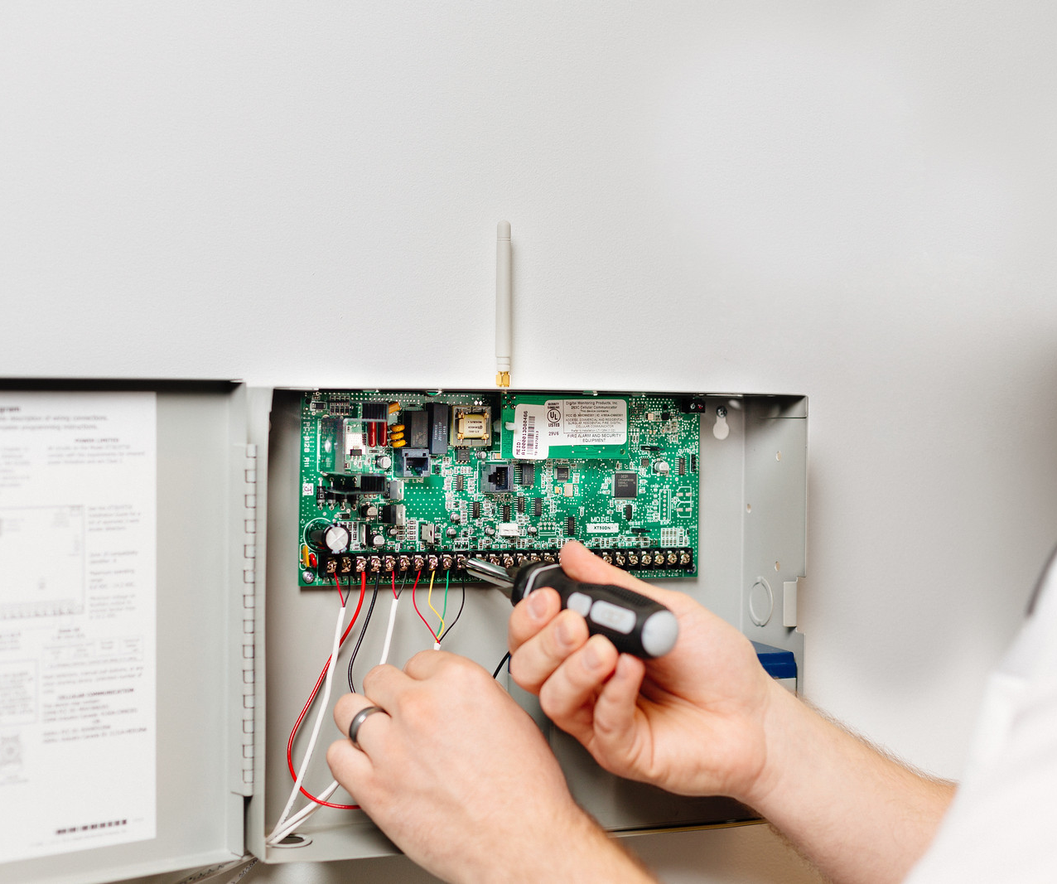
Technical Training
Initial Training & Install
Introduction to DMP products, programming, and wiring
Install DMP panel with RTM guidance
Follow up with DMP University continuation plan
10 lessons, 2-5 minutes in length over the next 30 days

Slide 4


Slide 5
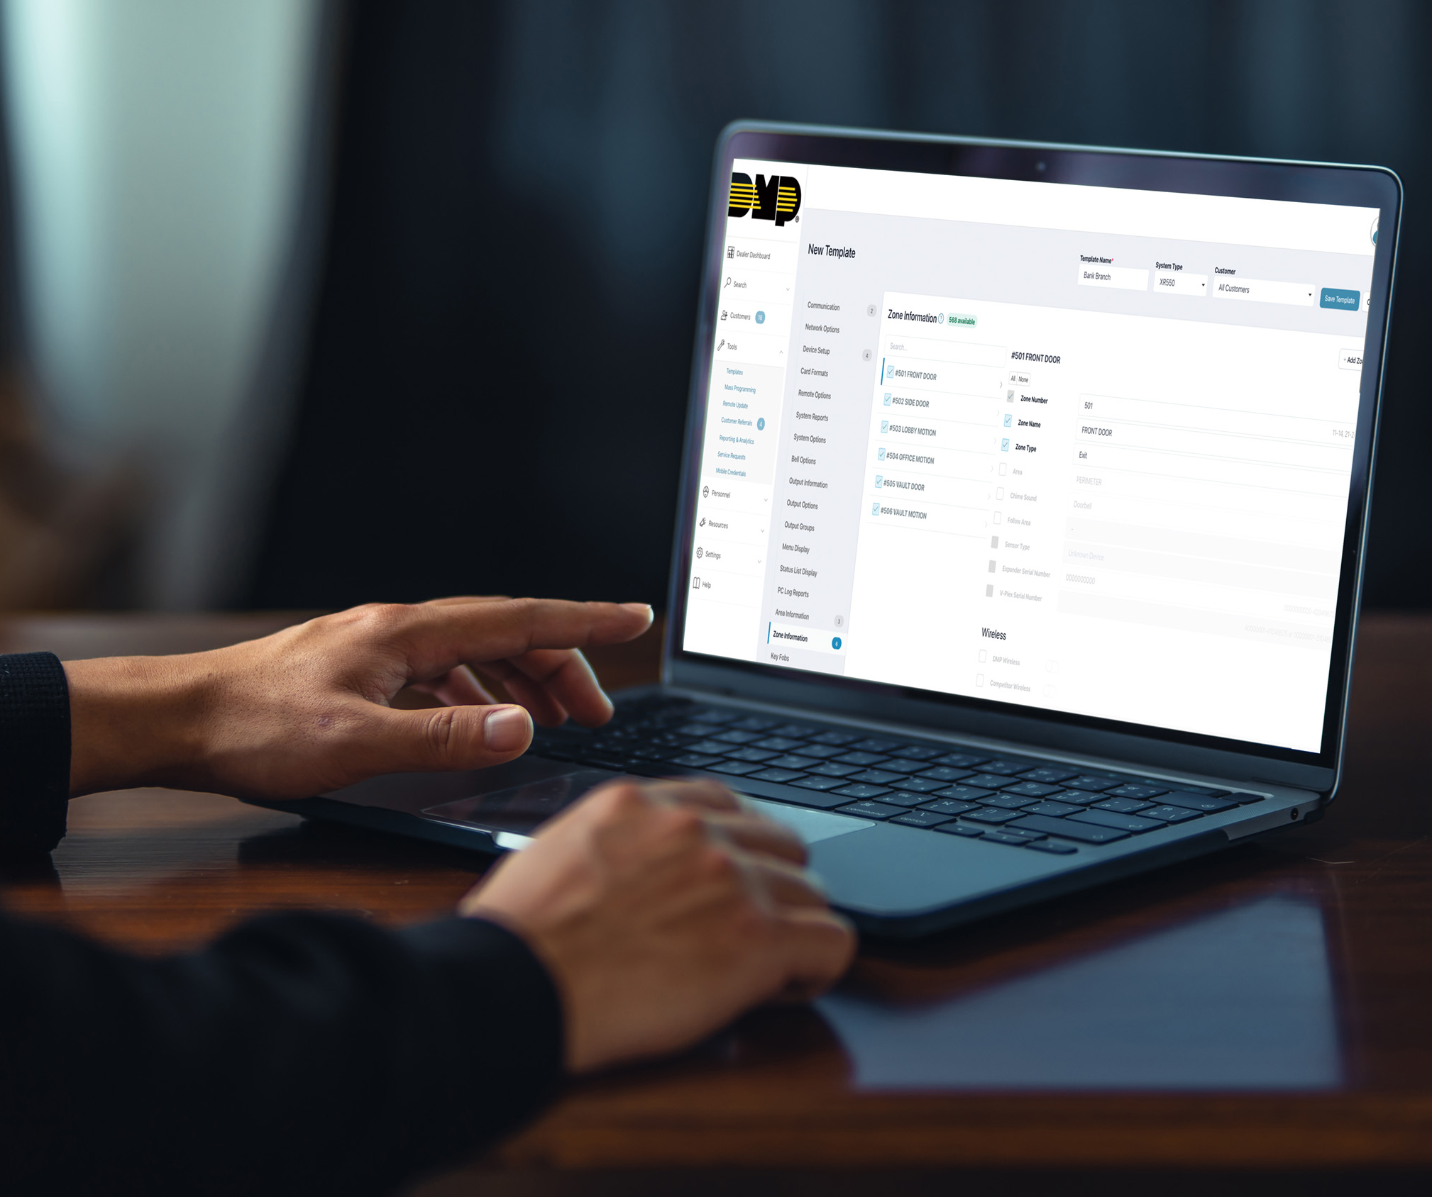
Technical Training
Deep Dive
Utilize tech support calls to identify specific needs then create and deliver tailored advanced level training
Webinars
Provide quick response information and can be scheduled with shorter lead times

Slide 6

Technical Training
Embedding
In the field with technicians sharpening knowledge and providing best practices
On Site Troubleshooting
Teaching valuable steps to diagnose, service, and remedy problems encountered in the field

Slide 7
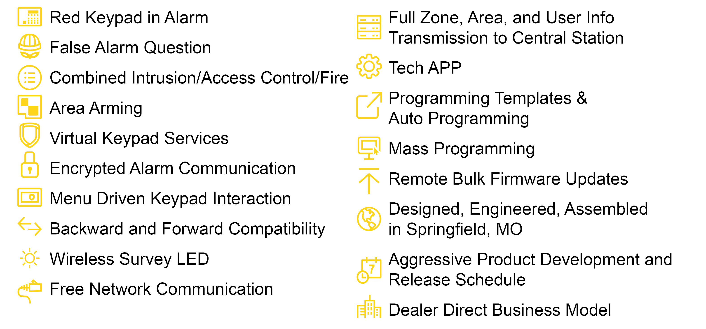
DMP Distinctives

Slide 8
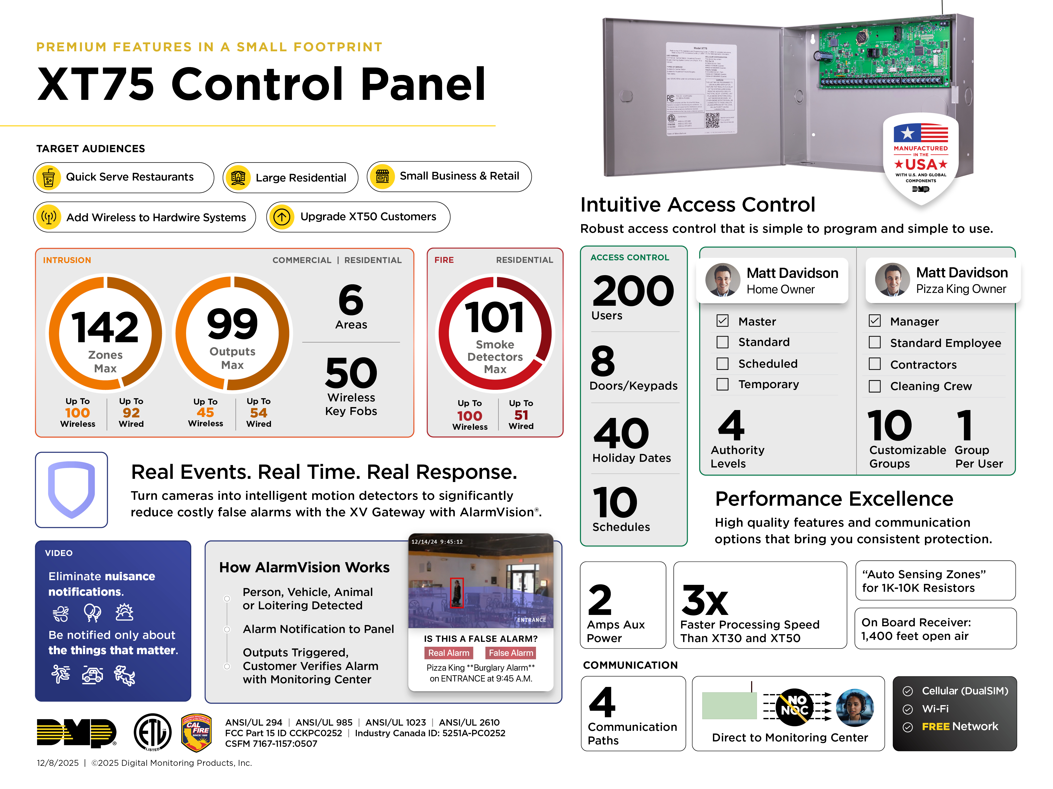
Notes:
Feature Basics

Slide 9
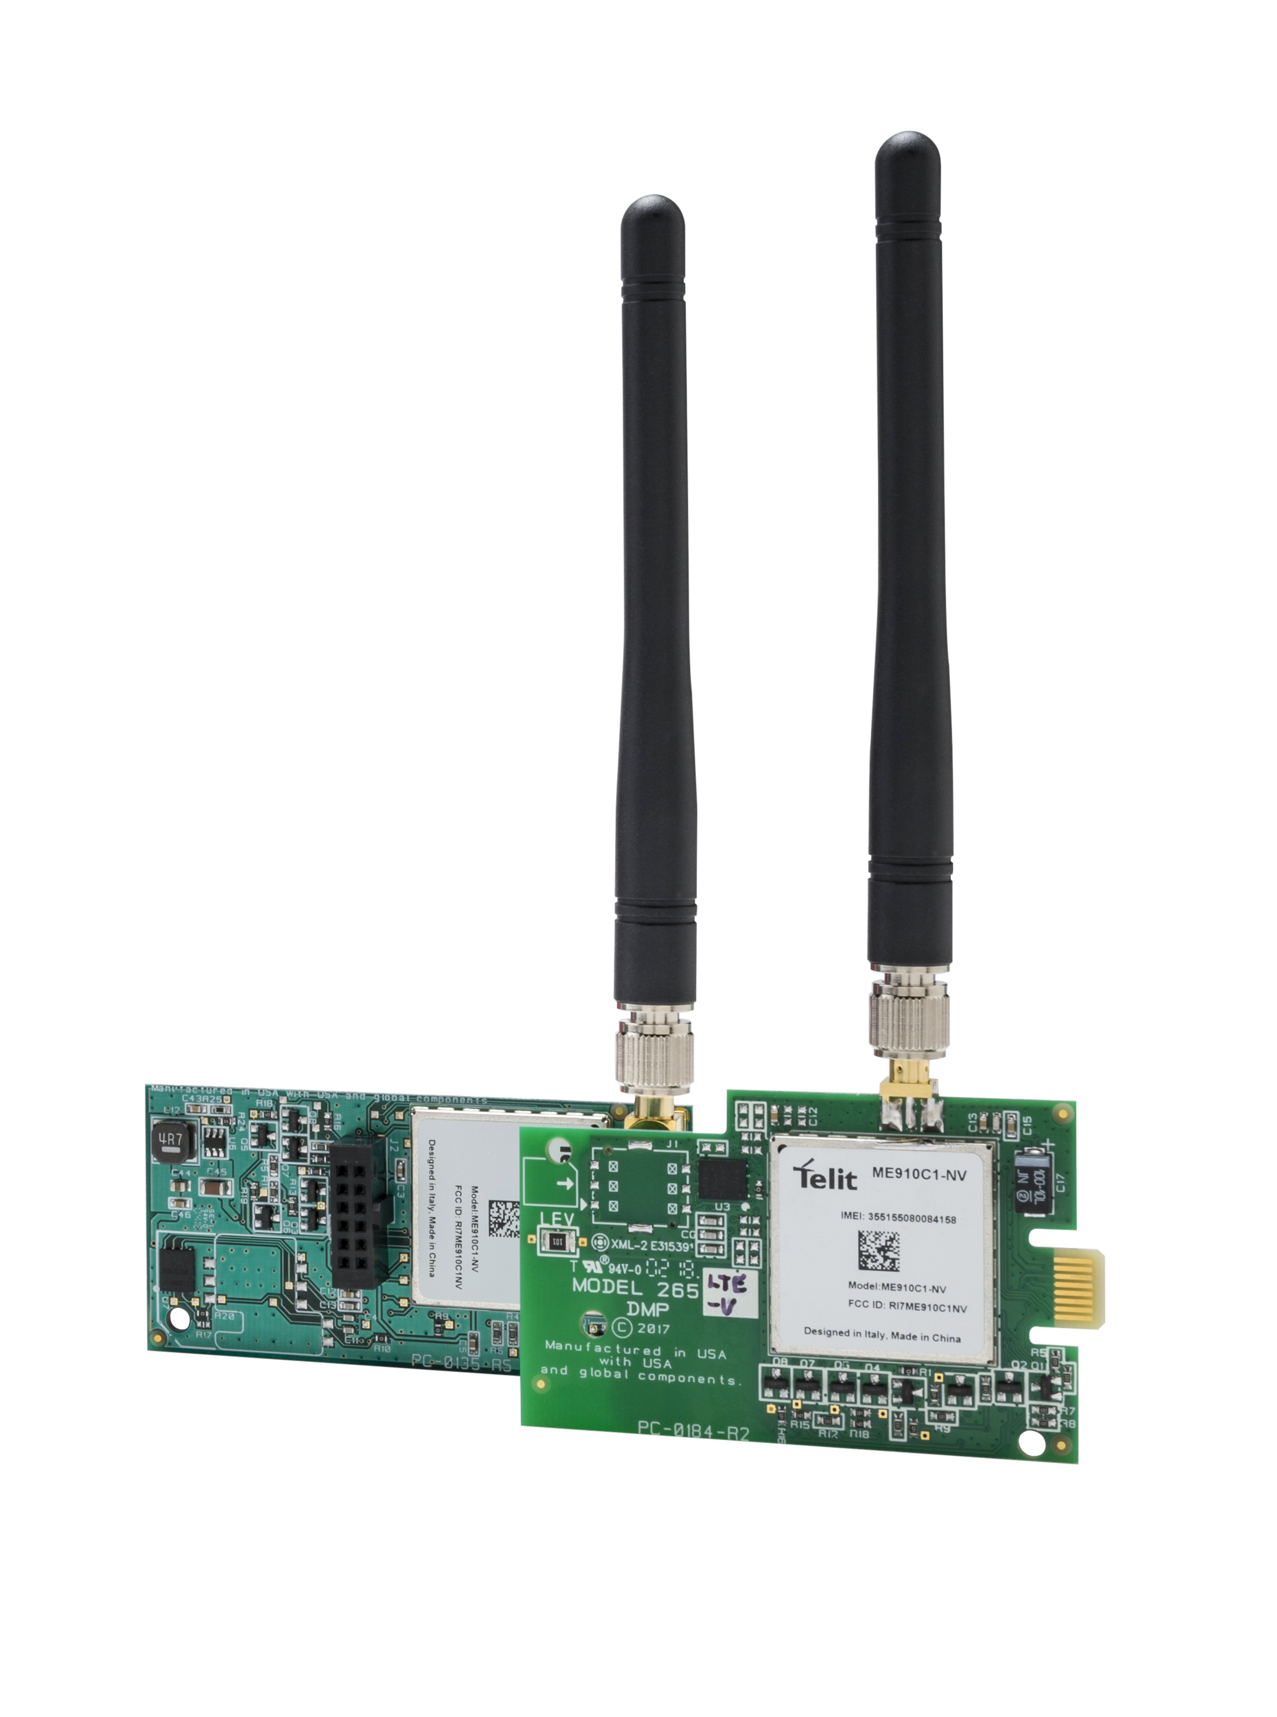
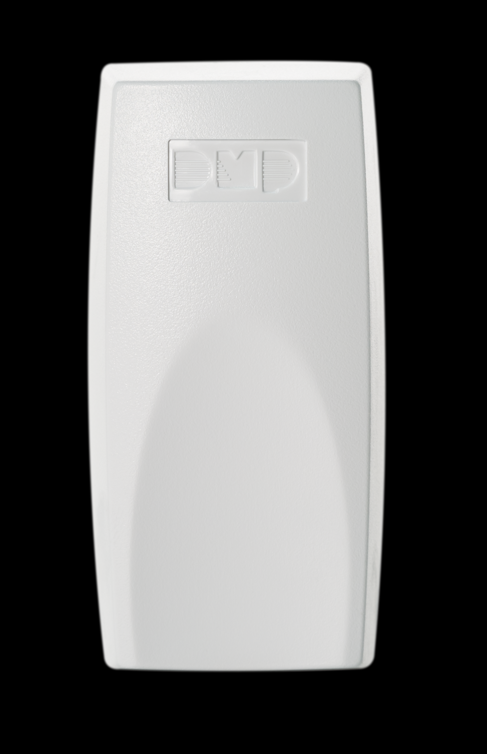

Panel Communication Options
Network Communication
Cellular Communication
Wi-Fi Communication
Notes:
Network Communication
DMP offers free network communication
Cellular Communication
263LTE Cellular Communicator
263LTE-2 Cellular Communicator
263LTE FirstNet Ready Cellular Communicator
Wi-Fi Communication
763 Wi-Fi Interface Module

Slide 10
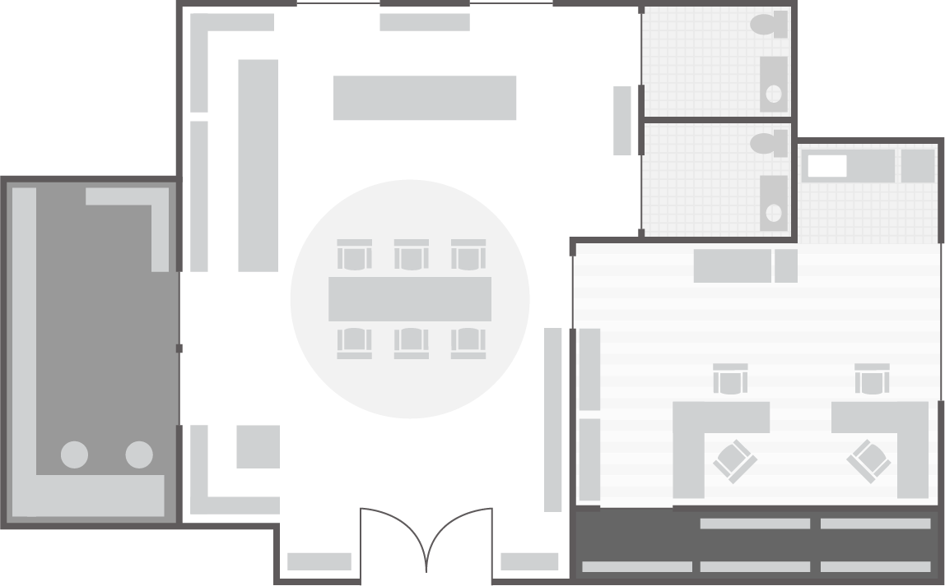
Site Survey
Today’s Install
XT
7872
WIRED
1106
1106
1106
1127
1126
1106
1106
Notes:
Site Survey
Installers should survey the entire site before starting any installation. Discuss considerations for panel and zone placement with the class:
PANEL PLACEMENT
Centrally located
Secure—Inaccessible for any customers or potential intruders
Dry location
Away from large metal objects
Dedicated outlet nearby
Grounding rod or cold water pipe nearby
Within range of all wireless sensor locations
WIRED ZONE PLACEMENT
Can you run a wire to each location? Will it look clean?
WIRELESS ZONE PLACEMENT
Within range of panel or wireless receiver
Sources of interference: Other wireless transmitters, large metal objects, and microwaves
KEYPAD BUS DEVICE PLACEMENT
Length of wire runs: There is no standard maximum length, but the panel will not allow a voltage drop to any device of over 2.0VDC. If you encounter a voltage drop of more than 2.0VDC, you’ll need to use an auxiliary power supply.

Slide 11
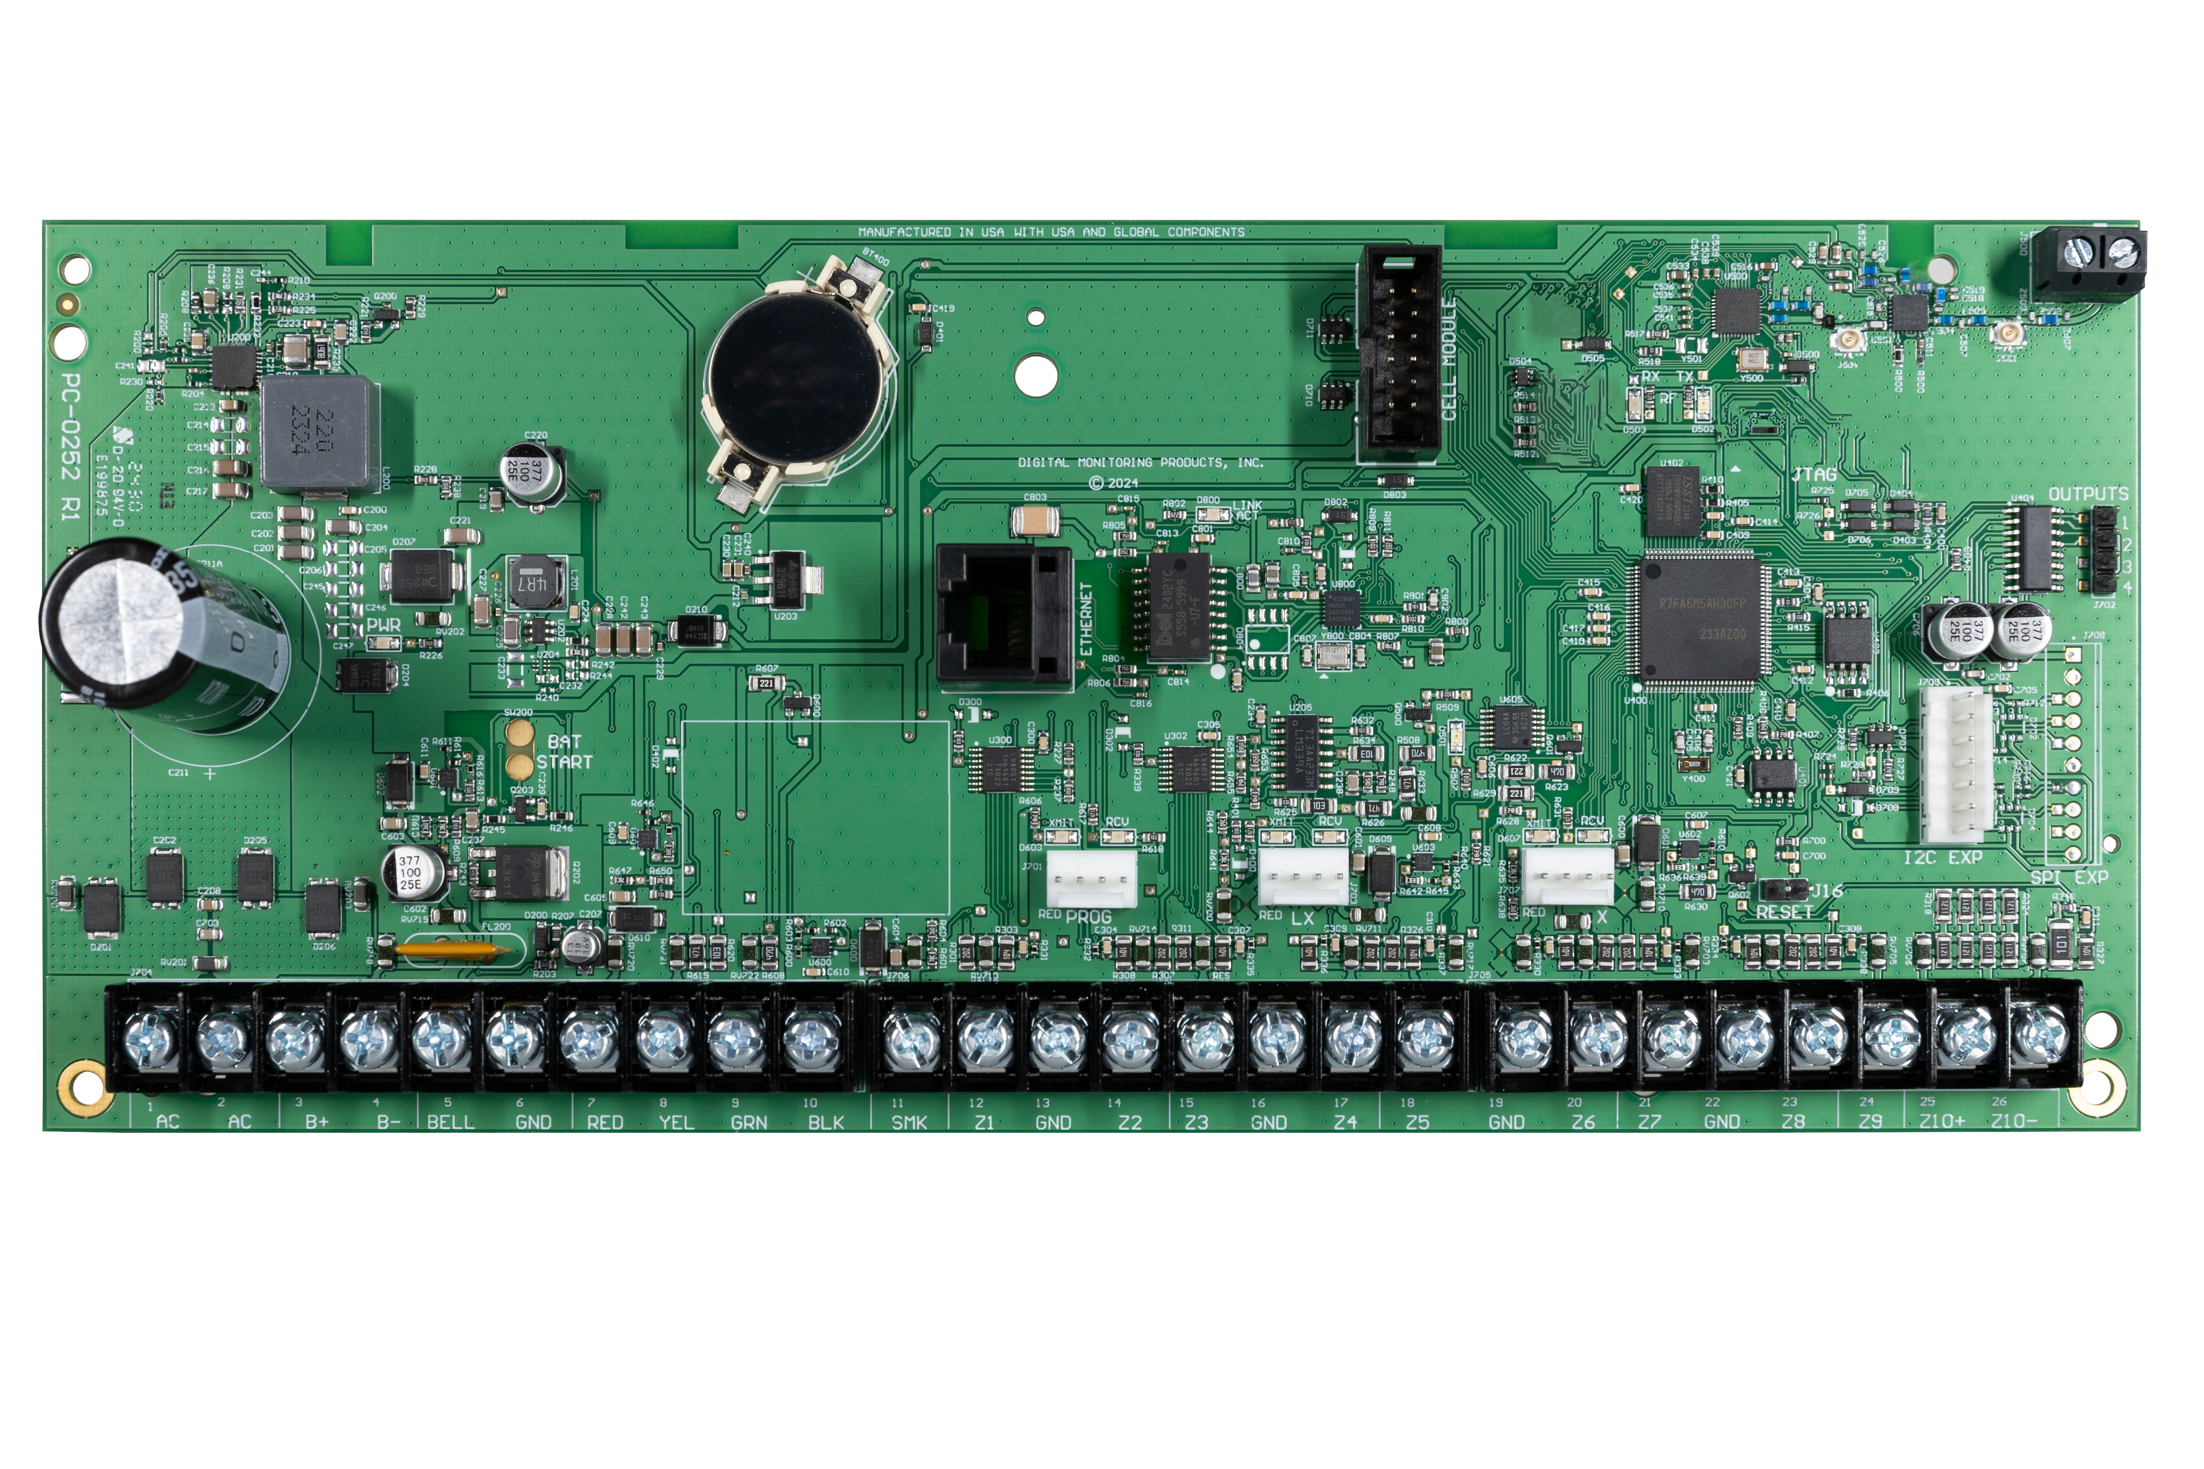
LAB: Identify Components

Slide 12
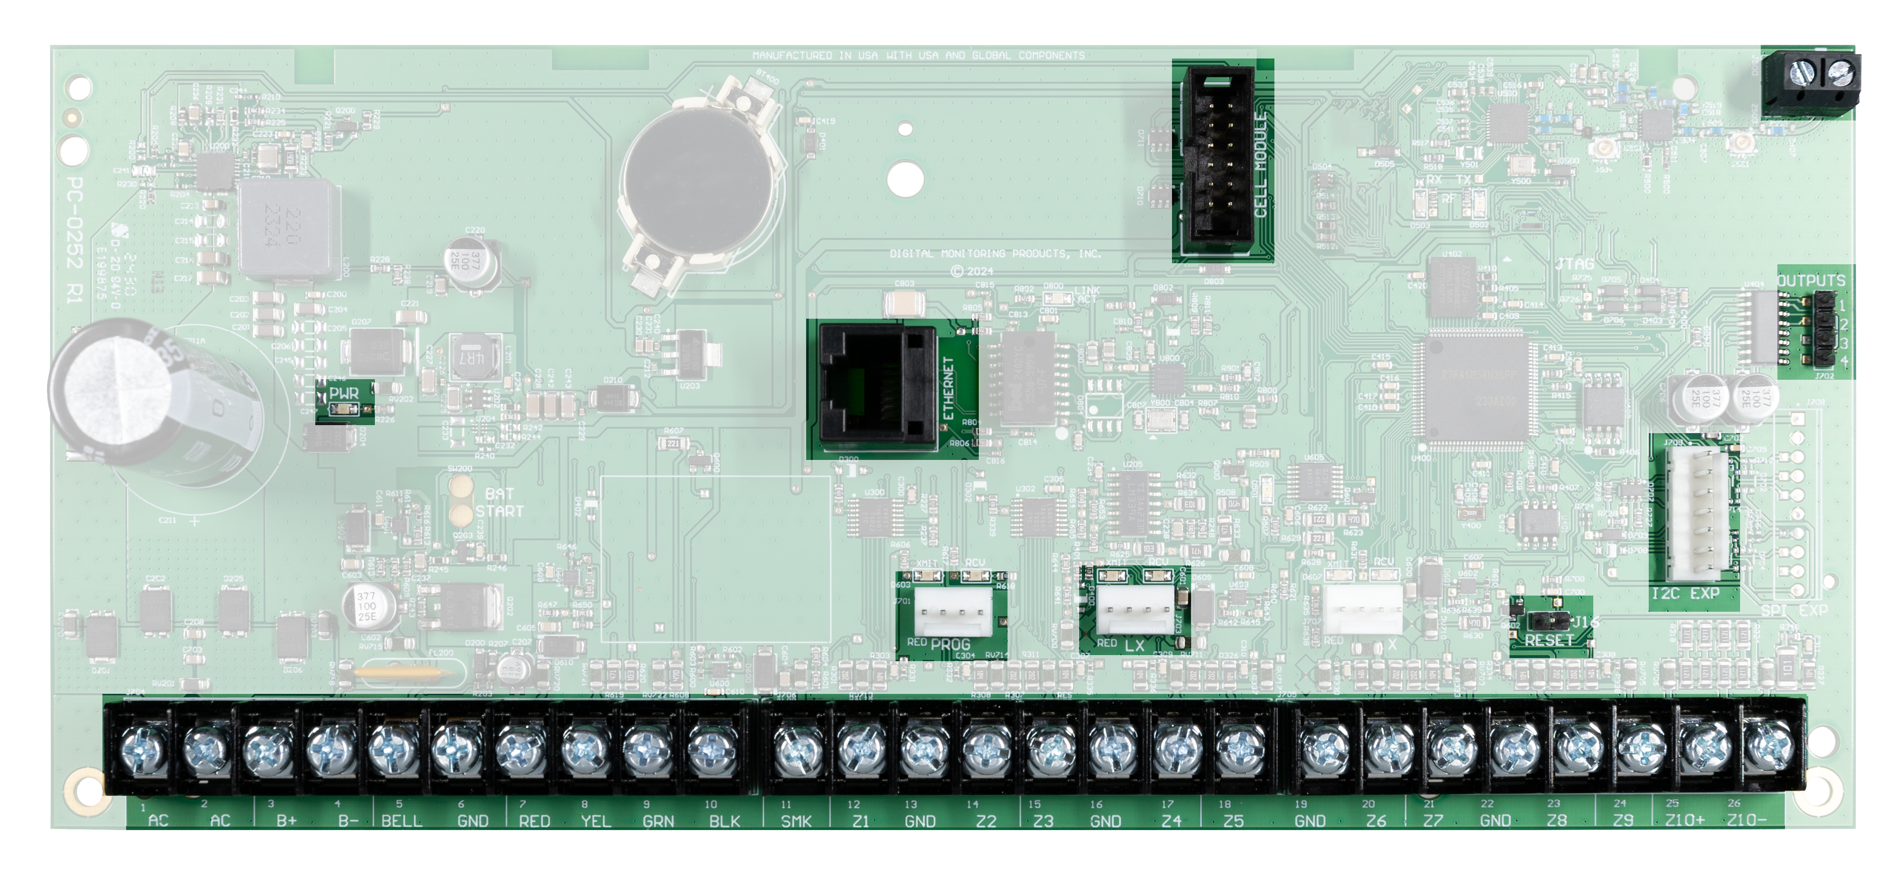
LAB: Identify Components

Slide 13
XT75 Programming Sections
Initialization
Communication
Network Options
Device Setup
Remote Options
System Reports
System Options
Bell Options
Output Options
Output Setup
Area Information
Zone Information
Stop
Set Lockout Code

Slide 14
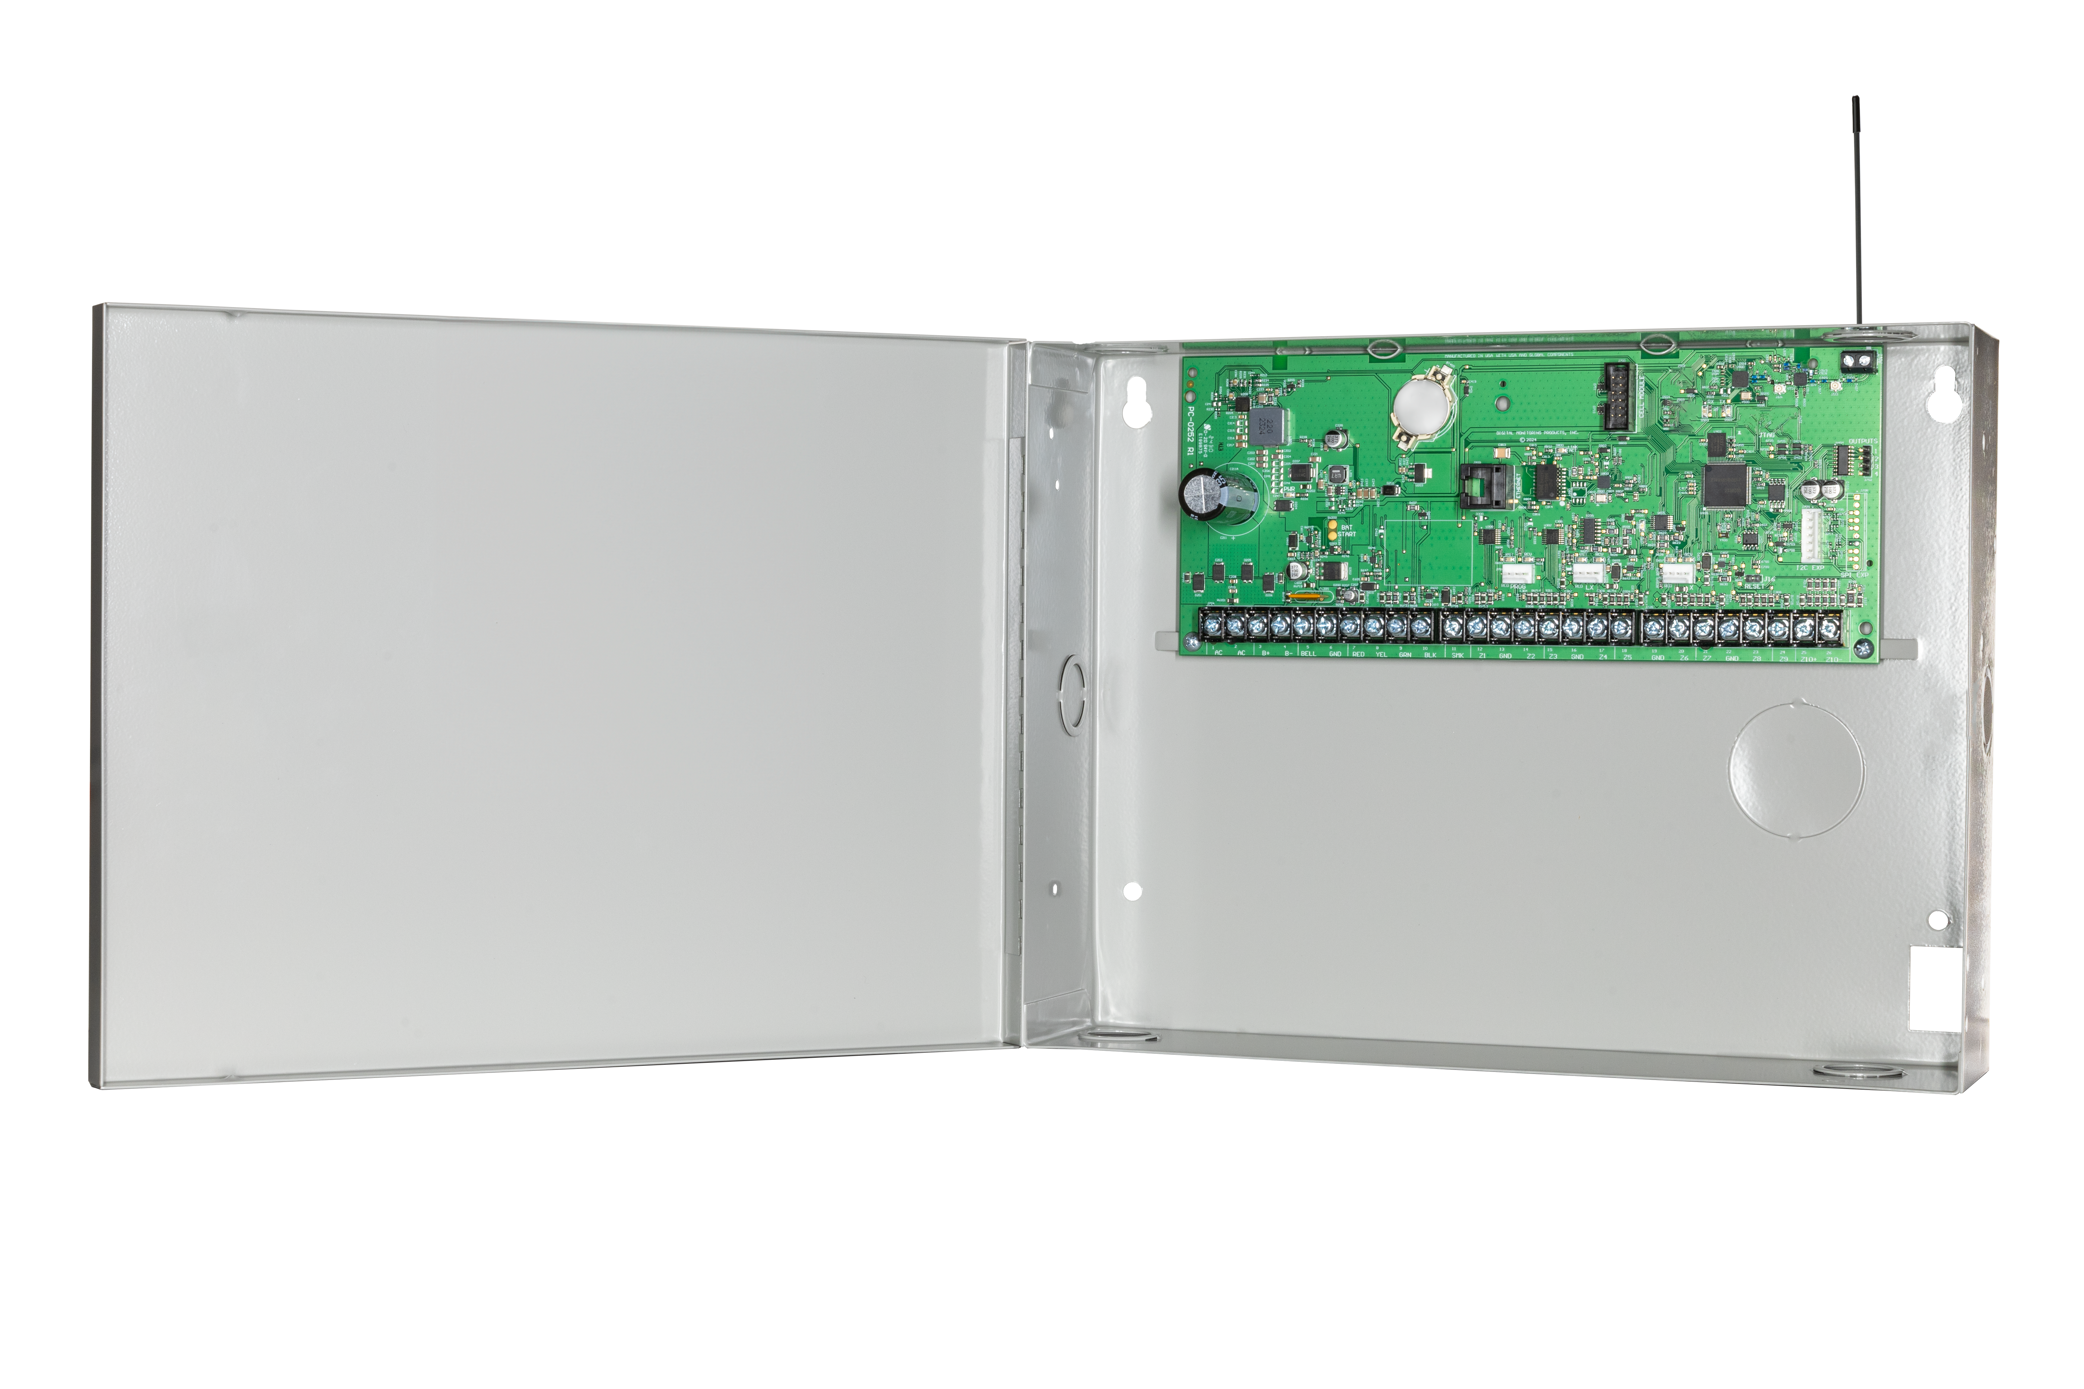
Questions?
20351

Slide 15
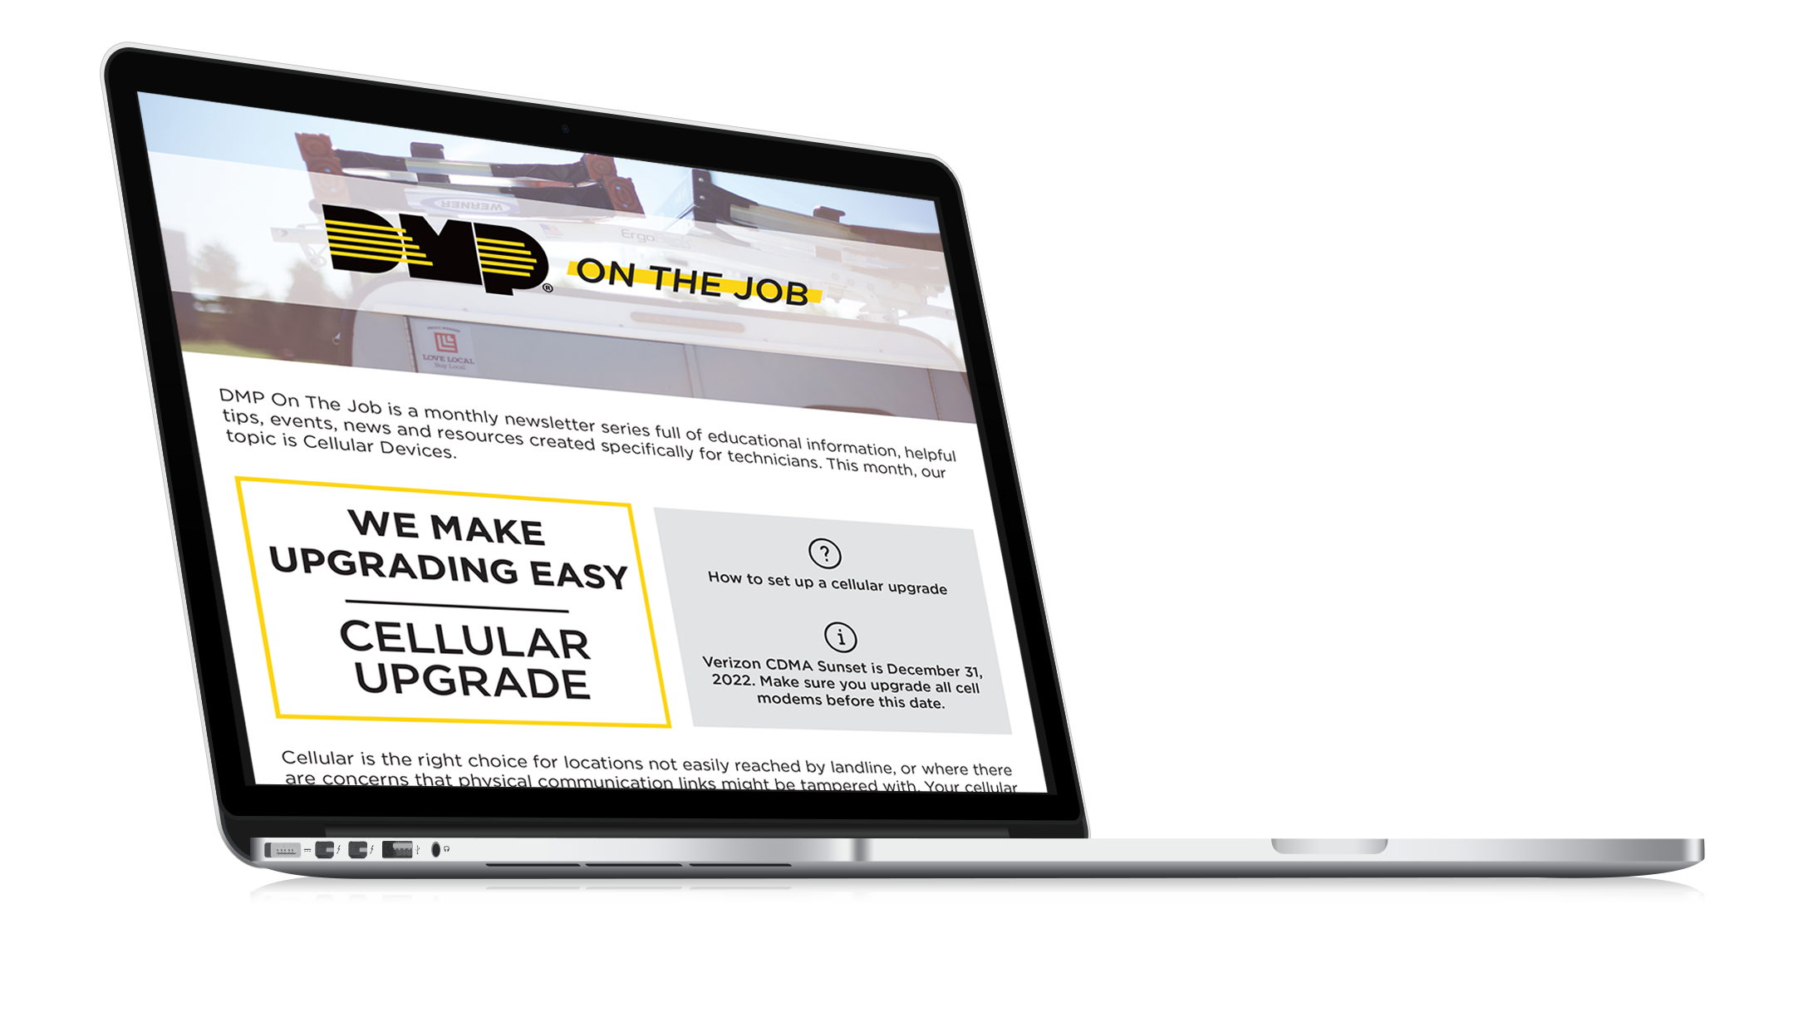
Digital Newsletter
Monthly newsletter
Covering educational information, helpful tips, upcoming training events, news, and resources created specifically for technicians
Highlights a Tech Support Representative
Has surveys that you can take to be entered to win prizes

